Slide 1
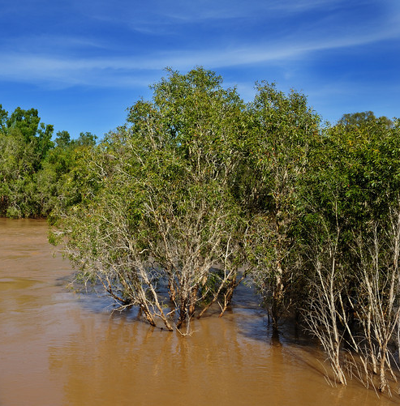
Floods: an overflow of water onto dry land
Floods can have an immediate impact on plant growth and germination of seeds.
The nests and burrows of smaller animals can be destroyed, so the animals move to higher ground.
Some animals benefit from floods.
Fish breed in flooded lakes, more water plants grow and more insects breed.
This abundance of food attracts water birds.

Slide 2
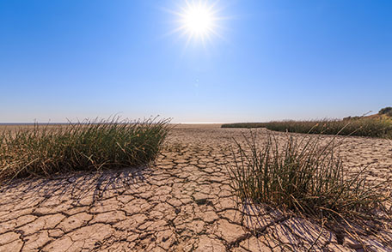
Drought: a period of abnormally low rainfall, leading to a shortage of water
During drought, animals migrate (move) elsewhere until conditions improve.
Moisture in the soil is essential for the function of decomposers, such as bacteria and fungi.
Without decomposers to break down organic material, soil quality declines.
The dry top-soil can be blown away through wind erosion.
The wind erosion removes essential nutrients for plants and animals in the ecosystem.

Slide 3
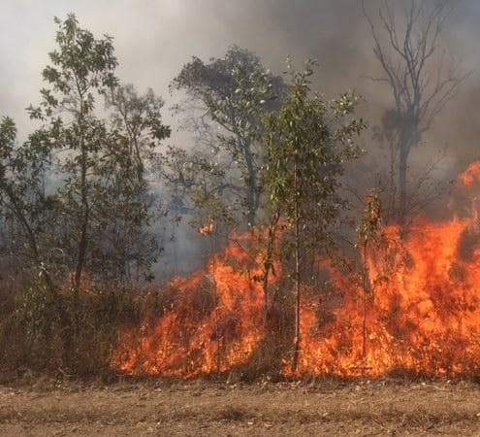
Bushfire: a fire in grass, bush or woodland
Bushfires can both help and harm an ecosystem.
Fires can destroy plant and animal life.
Some animals can sense a fire and escape to other areas or underground burrows, although when they return, their food sources may be destroyed.
Fires clear out dead vegetation, so plants that survive benefit from increased light
Many native Australian plants have adapted a fire resistance and rely on fires to complete their life-cycle.

Slide 4
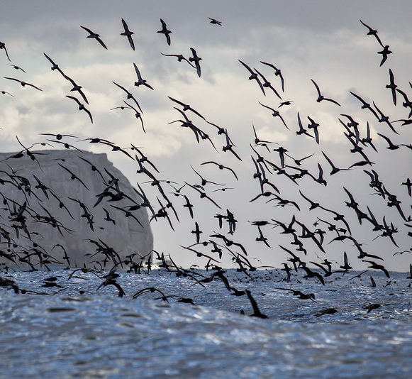
Seasonal Changes: changes in rainfall, temperature and daylight due to the seasons
When the weather becomes colder, many animals migrate (move) to areas with warmer temperatures.
As a result, their population increases in one area and decreases in another.
During the breeding season, usually spring, the population size will increase.
Some animals hibernate during the colder months, when food sources become more limited.

Slide 5
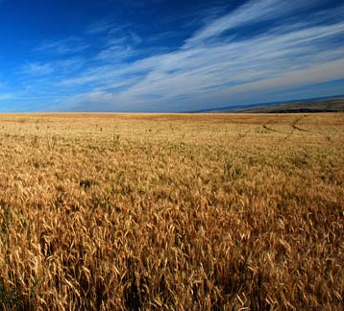
Habitat Destruction: natural habitats being removed or replaced with a different habitat
Land used to build houses or grow crops may no longer be suitable for the organisms that once lived there.
The populations of organisms must relocate to a new area or adapt to the change in environment.
When organisms are unable to relocate or adapt, their numbers decline and the species can become endangered or extinct.

Slide 6
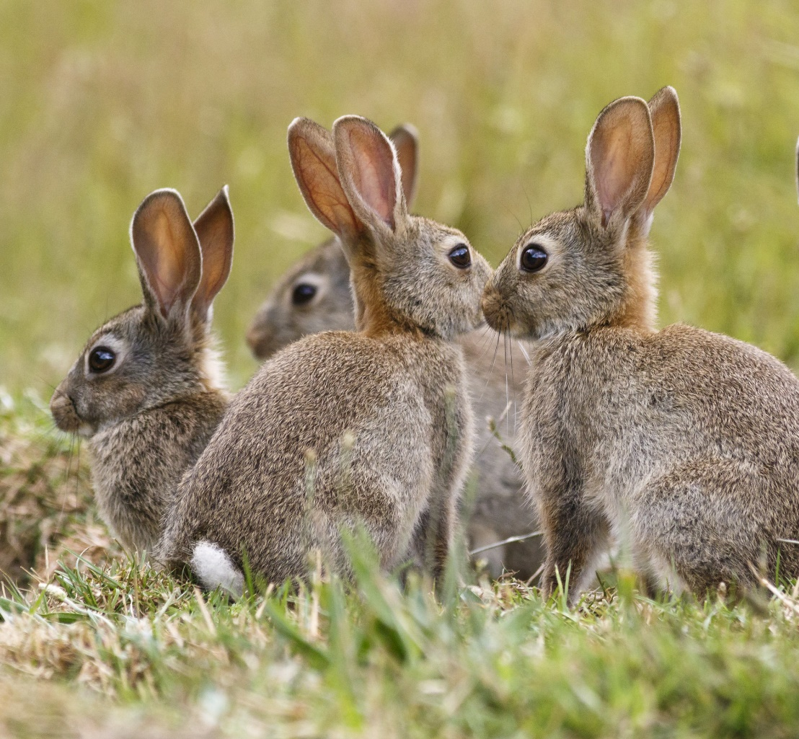
Introduced Species: organisms moved by humans into an area where they are not native
When a new species is introduced into an ecosystem, it may not have an natural predators or controls.
They can breed and spread quickly, taking over an area.
Introduced species prey on native species and compete for food and other resources.
They can also carry new diseases.

Slide 7
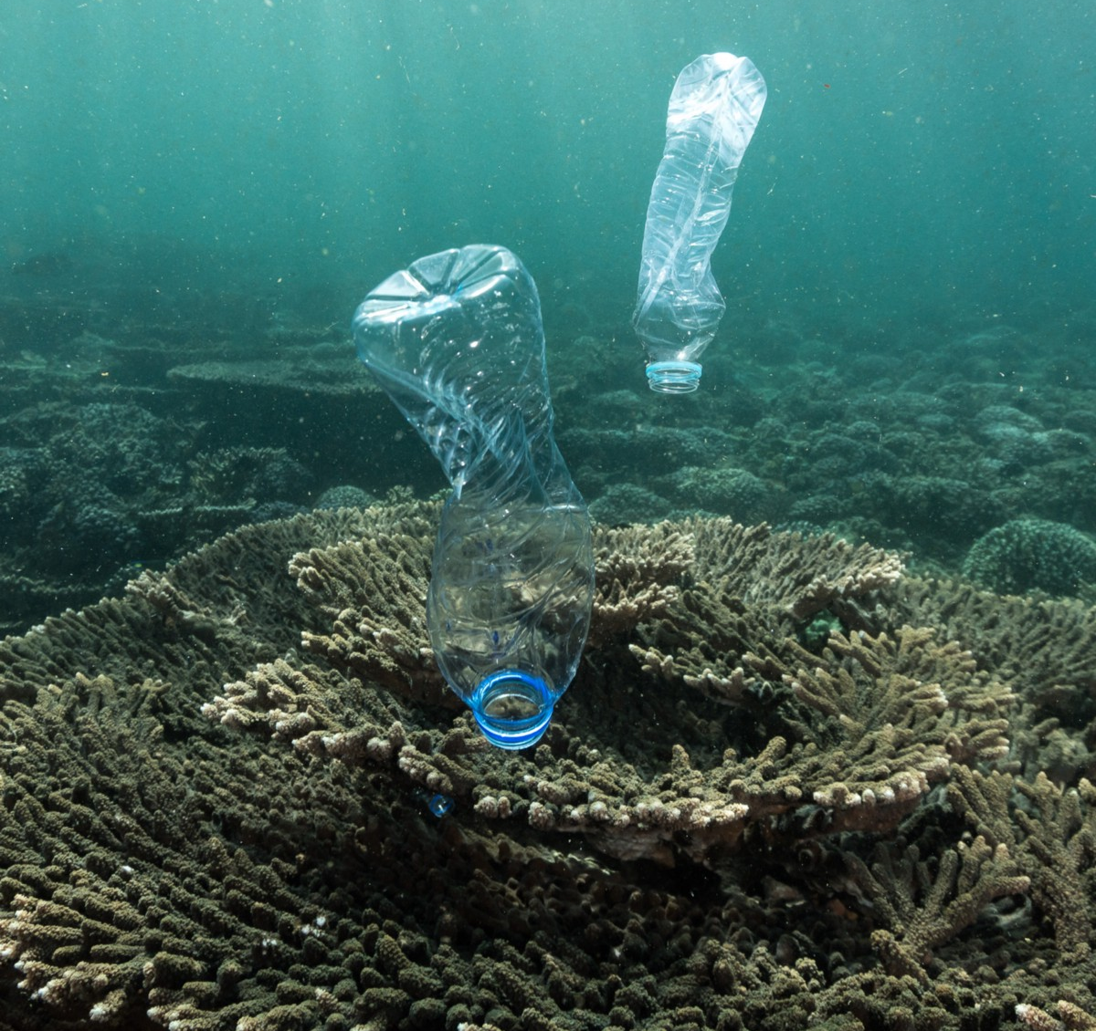
Pollution: the introduction of unwanted chemicals and objects into ecosystems
Certain chemicals can cause sickness or death of species in an ecosystem.
When chemicals are washed into rivers and lakes, some aquatic plant species grow rapidly and compete for resources with other plants.
Household rubbish can trap animals or be mistaken for food, causing physical harm to the animal.

Slide 8
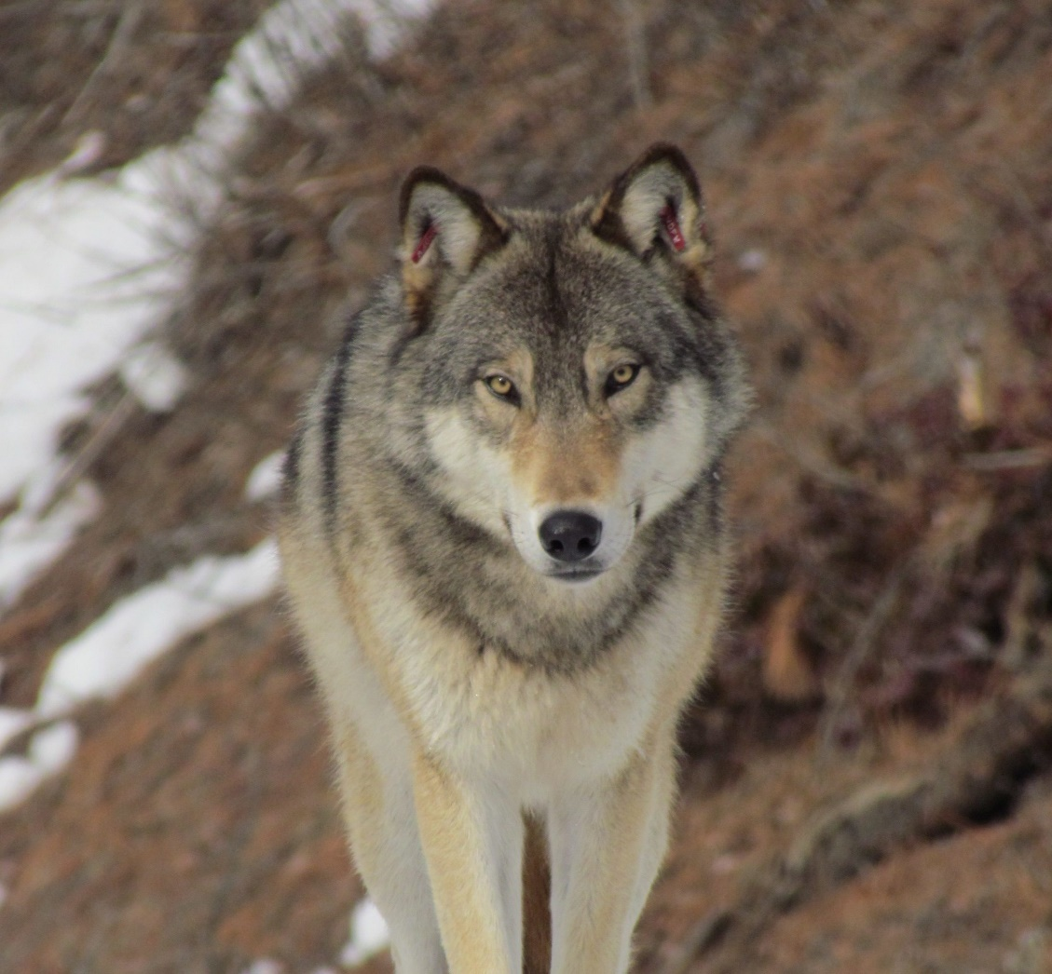
Overhunting: hunting a species to the point where the species becomes scarce or extinct
Humans have hunted or killed animals for several reasons, including for food and materials.
They protected livestock by trapping or hunting native animals.
Removing some predatory species can cause their prey to over-populate the environment.
This can lead to destruction of vegetation and changes to the ecosystem.

